Slide 1
Internet of Things and 6G

Slide 2
Introduction to IoT
The Internet of Things (IoT) refers to a network of physical objects (sensors, appliances, vehicles, etc.) embedded with software and connectivity, enabling them to collect/share data.
IoT is growing explosively: ~16.6 billion devices were connected by end-2023, projected to ~18.8 billion by end-2024.
These devices span virtually all sectors (smart manufacturing, transportation, healthcare, agriculture, smart homes, etc.), and their proliferation is rapidly transforming industry and daily life.

Slide 3
Limitations of 5G for IoT
Coverage gaps: 5G’s high-frequency (mm Wave) deployments have limited range and poor propagation, leading to coverage holes in rural/remote areas
High deployment cost: Building dense 5G infrastructure (base stations, small cells) is expensive, especially for sparsely populated regions
Power consumption: 5G IoT devices and networks consume more energy than 4G counterparts, straining battery-operated sensors

Slide 4
What is 6G? Key Features
6G is the upcoming sixth-generation wireless standard (targeted ~2030) that promises extraordinary performance beyond 5.
Its envisioned key features include: ultra-high data rates (using terahertz and sub-THz bands), ultra-low latency (<1 ms), AI-driven self-optimizing networks, and ubiquitous coverage (integrating terrestrial, airborne and satellite links).
In short, 6G aims to blend communication with sensing and intelligence, enabling new services and applications at scale.

Slide 5
How 6G Will Transform IoT
MASSIVE DEVICE DENSITY: 6g is expected to support ~10 million devices per km² (vs. ~100,000 in 4g)
ULTRA-RELIABLE LOW-LATENCY COMMS: with end-to-end latency <1 ms and near-100% reliability, 6g can support mission-critical iot (remote surgery, industrial automation, ar/vr, etc.)
MULTI-CONNECTIVITY: devices will simultaneously leverage multiple links (cellular + wi-fi + satellite) for seamless connectivity even under link failures
ENERGY EFFICIENCY & INTELLIGENCE: ai-driven resource management will optimize power use and extend battery life of iot devices. altogether, 6g addresses current 5g limitations (latency, bandwidth, energy)

Slide 6
6G Technologies Enabling IoT (THz, RIS, NTNs)
Terahertz (THz) communication: 6G will explore sub-THz bands (≈90–300 GHz) to access vast new spectrum.
Reconfigurable Intelligent Surfaces (RIS): Metasurface panels that smartly reflect and beamform signals. RIS can extend coverage and boost capacity with low power usage. They offer high array gains at low cost and energy.
Non-Terrestrial Networks (NTN): Satellites (LEO/MEO/GEO), high-altitude platforms (drones, balloons), and UAVs will be integrated as part of 6G. NTNs extend 6G coverage to remote areas and enable global IoT connectivity
Future 6G-IoT systems will blend these layers (ground + air + space) for seamless service.

Slide 7
Real-World 6G-IoT Trials and Testbeds
Nokia (Dec 2024): At its Dallas HQ, Nokia plans a 6G trial in the 7.125–7.525 GHz band with 4 prototype 6G base stations and 10 devices.
NTT Docomo (Nov 2024): In Japan, Docomo, Nokia and SK Telecom demonstrated an indoor 6G link (4.8 GHz, using AI for signal processing) achieving ≈18% throughput gain over conventional methods. This experiment is part of Docomo’s “6G Harmonized Intelligence” program toward an AI-powered network.
International projects: Research consortia like Finland’s 6G Flagship and Korea’s IITP launched the 6G-WISECOM project (2024–27) to co-develop “Integrated Sensing and Communication” (ISAC) for 6G

Slide 8
Technical Challenges and Lessons Learned
High-frequency propagation: THz signals suffer severe path loss and require line-of-sight or dense small cells. Developing RF components (antennas, amplifiers) that work at THz is challenging
RIS limitations: Simple (passive) RIS cannot magically amplify; they face a “multiplicative fading” problem in some scenarios, so advanced (active) RIS designs are needed
Energy constraints: Billions of IoT sensors demand ultra-low-power operation. 6G’s challenge is to drastically lower network/device energy use.
Security & privacy: A vastly expanded IoT means a much larger attack surface. Protecting data and devices is harder when “everything is connected.

Slide 9
Emerging Applications (Smart Cities, Healthcare, etc.)
Smart Cities & Transport: Dense IoT networks manage traffic, energy, pollution, and public safety in real-time. Connected vehicles and infrastructure (V2X) will coordinate via 6G for safer, smoother travel
Healthcare & Wearables: Continuous health monitoring (wearables, implantables) with instant alerts is enabled by 6G’s low latency and on-device AI. Telemedicine (e.g. remote surgery) becomes feasible with near-zero lag
Industry 4.0: Factories with thousands of sensors and robots can operate autonomously.
Agriculture & Environment: Smart farming (soil, water, climate sensors) and environmental monitoring rely on persistent IoT coverage.
Other: Advanced XR/Metaverse experiences, logistics/drone coordination, and even space-IoT etc

Slide 10
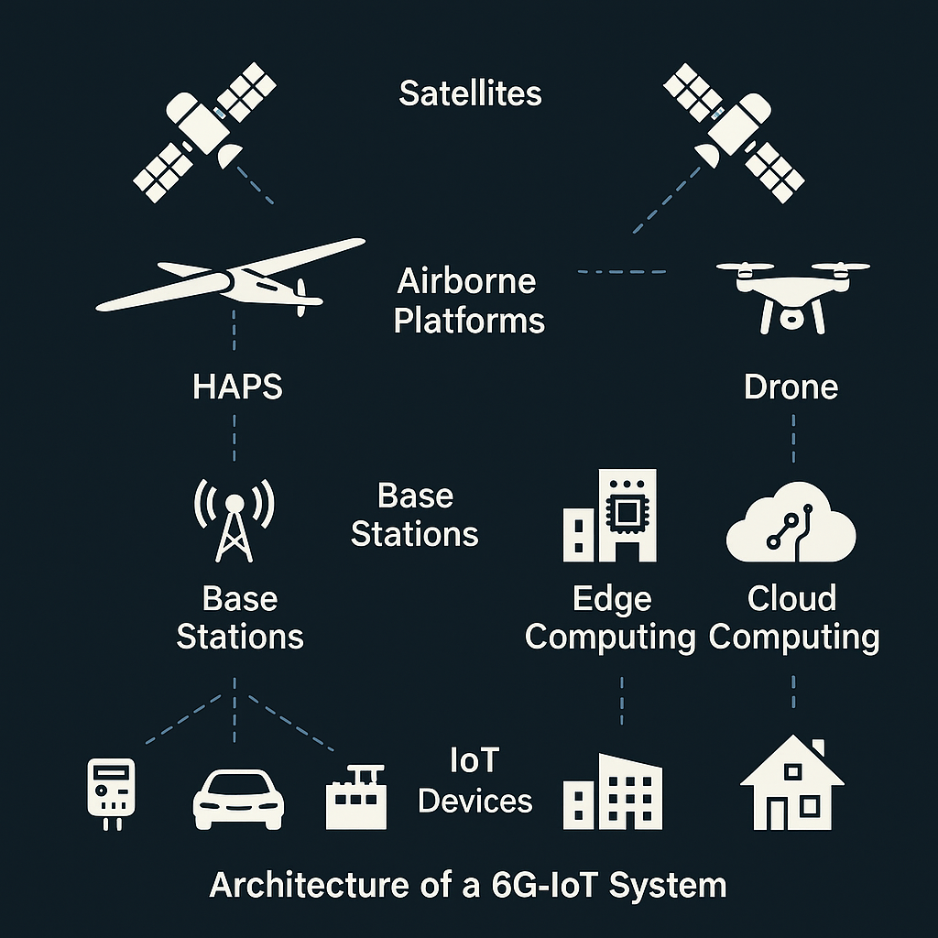
Architecture of a 6G-IoT System

Slide 11
Future Outlook for IoT in the 6G Era
Timeline: 6G is expected to roll out around 2030. Major R&D and standardization efforts (3GPP, ITU, national projects) are already underway worldwide.
Multi-network integration: Future IoT devices will seamlessly use multiple concurrent links (cellular, Wi-Fi, satellite, etc.) for resilience. Hybrid spectrum use (from sub-6 GHz up to THz) will be coordinated for optimal connectivity.
AI-centric networks: 6G is often described as a “network for AI”. Network intelligence at every layer (AI chips, digital twins, semantic communications) will adapt IoT services to user needs in real time.
Scale: IoT device counts will continue exploding; it is plausible that tens of billions of devices will be connected by 6G timeframe. This will drive new business models (e.g. IoT-as-a-Service).

Slide 12
Conclusion
6G represents the next leap in wireless connectivity for IoT. It aims to overcome 5G’s limits by leveraging new technologies (THz communication, RIS, NTNs, AI) to deliver orders-of-magnitude improvements in speed, latency, and intelligence.
Early trials by industry (e.g. Nokia, Docomo) and joint research projects are already validating core concepts.
In the 6G era, virtually all applications – from smart cities and autonomous systems to advanced healthcare and industrial automation – will benefit from seamless, intelligent IoT connectivity. University courses and research must stay abreast of these developments to prepare for this upcoming transformation.

Slide 13
Thank you

